Slide 1

Solo Coding Project: Gym App Review
Presenter: Nick Lekkas
Panel: A. McGilloway, A. Henderson, P. Sullivan & G24 Cohort
08.04.2021
‘A local gym has asked you to build a piece of software to help them to manage memberships, and register members for classes.
The app should show a list of all upcoming classes, allow the gym to create and edit Members & Classes, allow the gym to book members on to specific classes and show all members that are booked in for a particular class.’

Slide 2
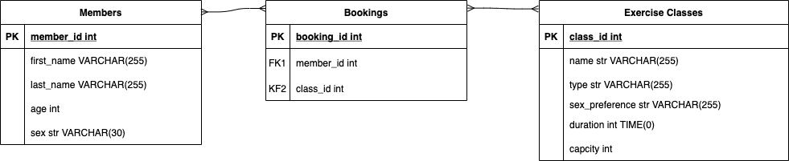
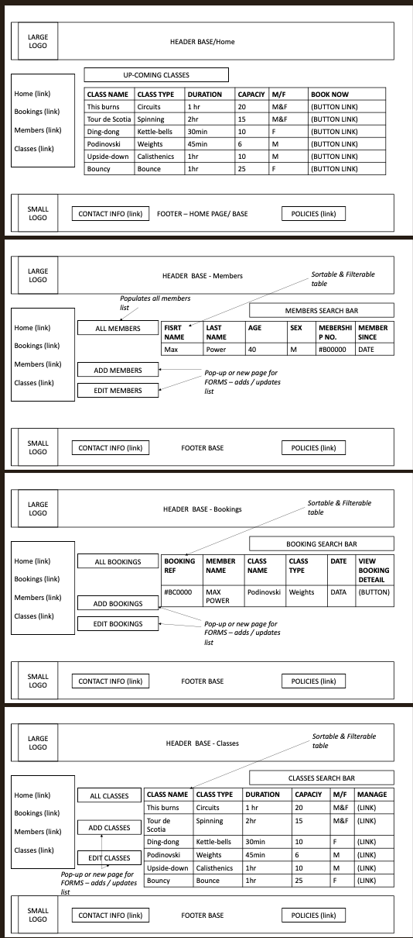
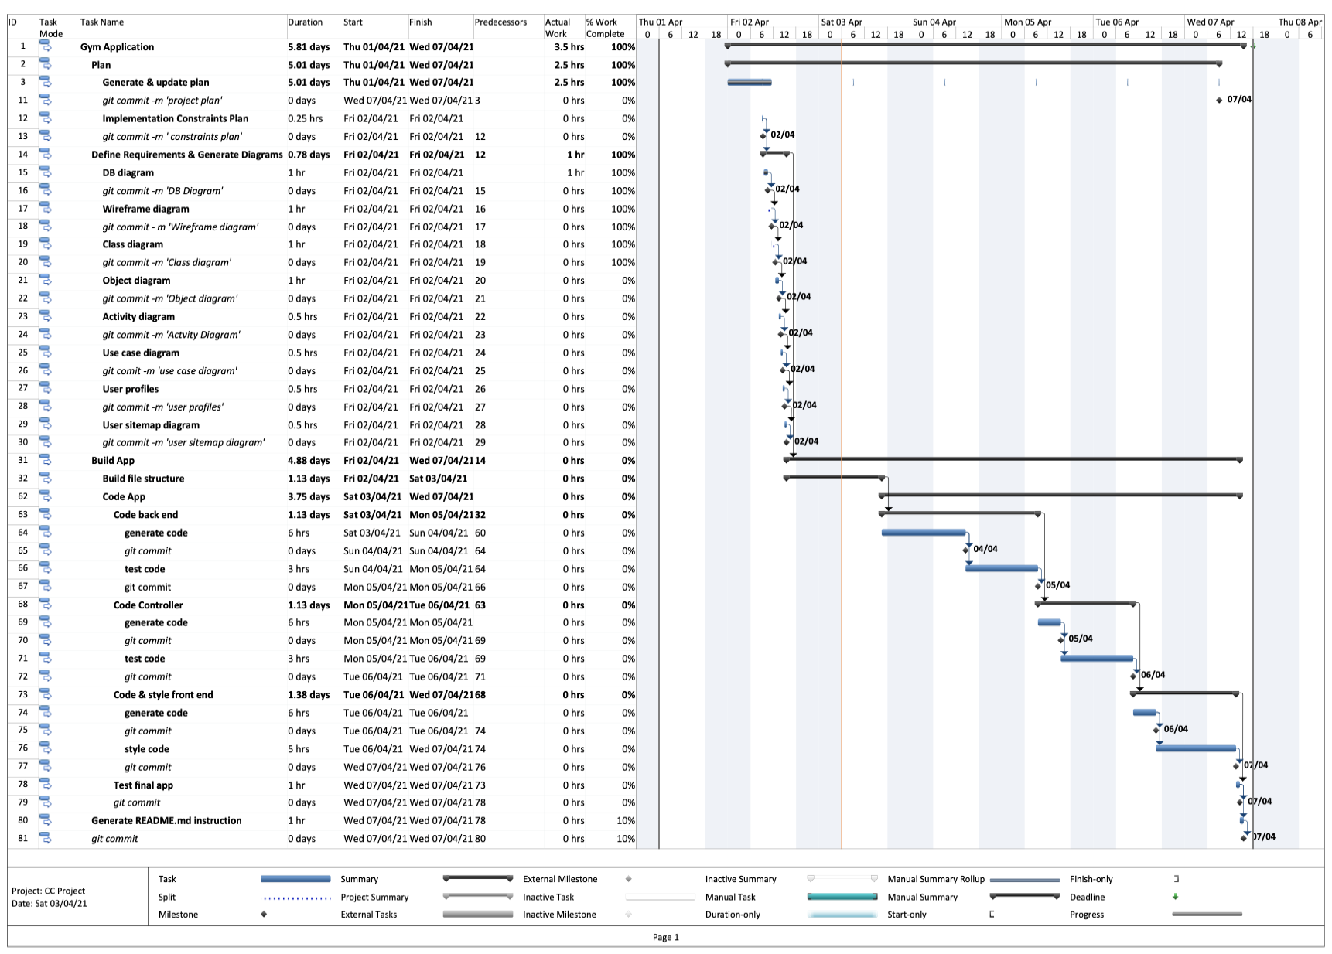
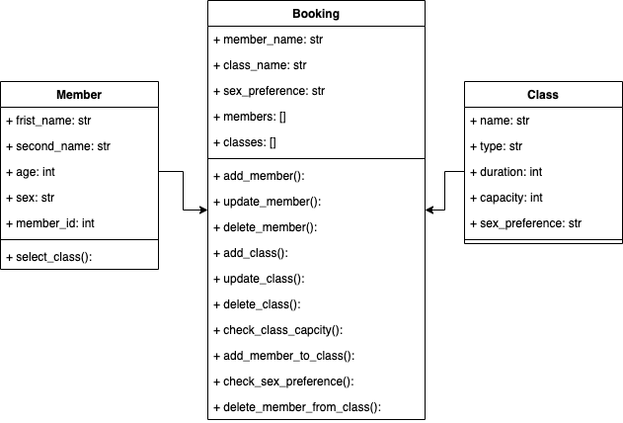
1. Programme Planning
Determine Tasks, WBS & estimates
Build detailed programme
Create DB diagram [many-to-many]
Generate Class diagram
Develop Wireframes
Iterate
Plan
Do
Check
Act

Slide 3
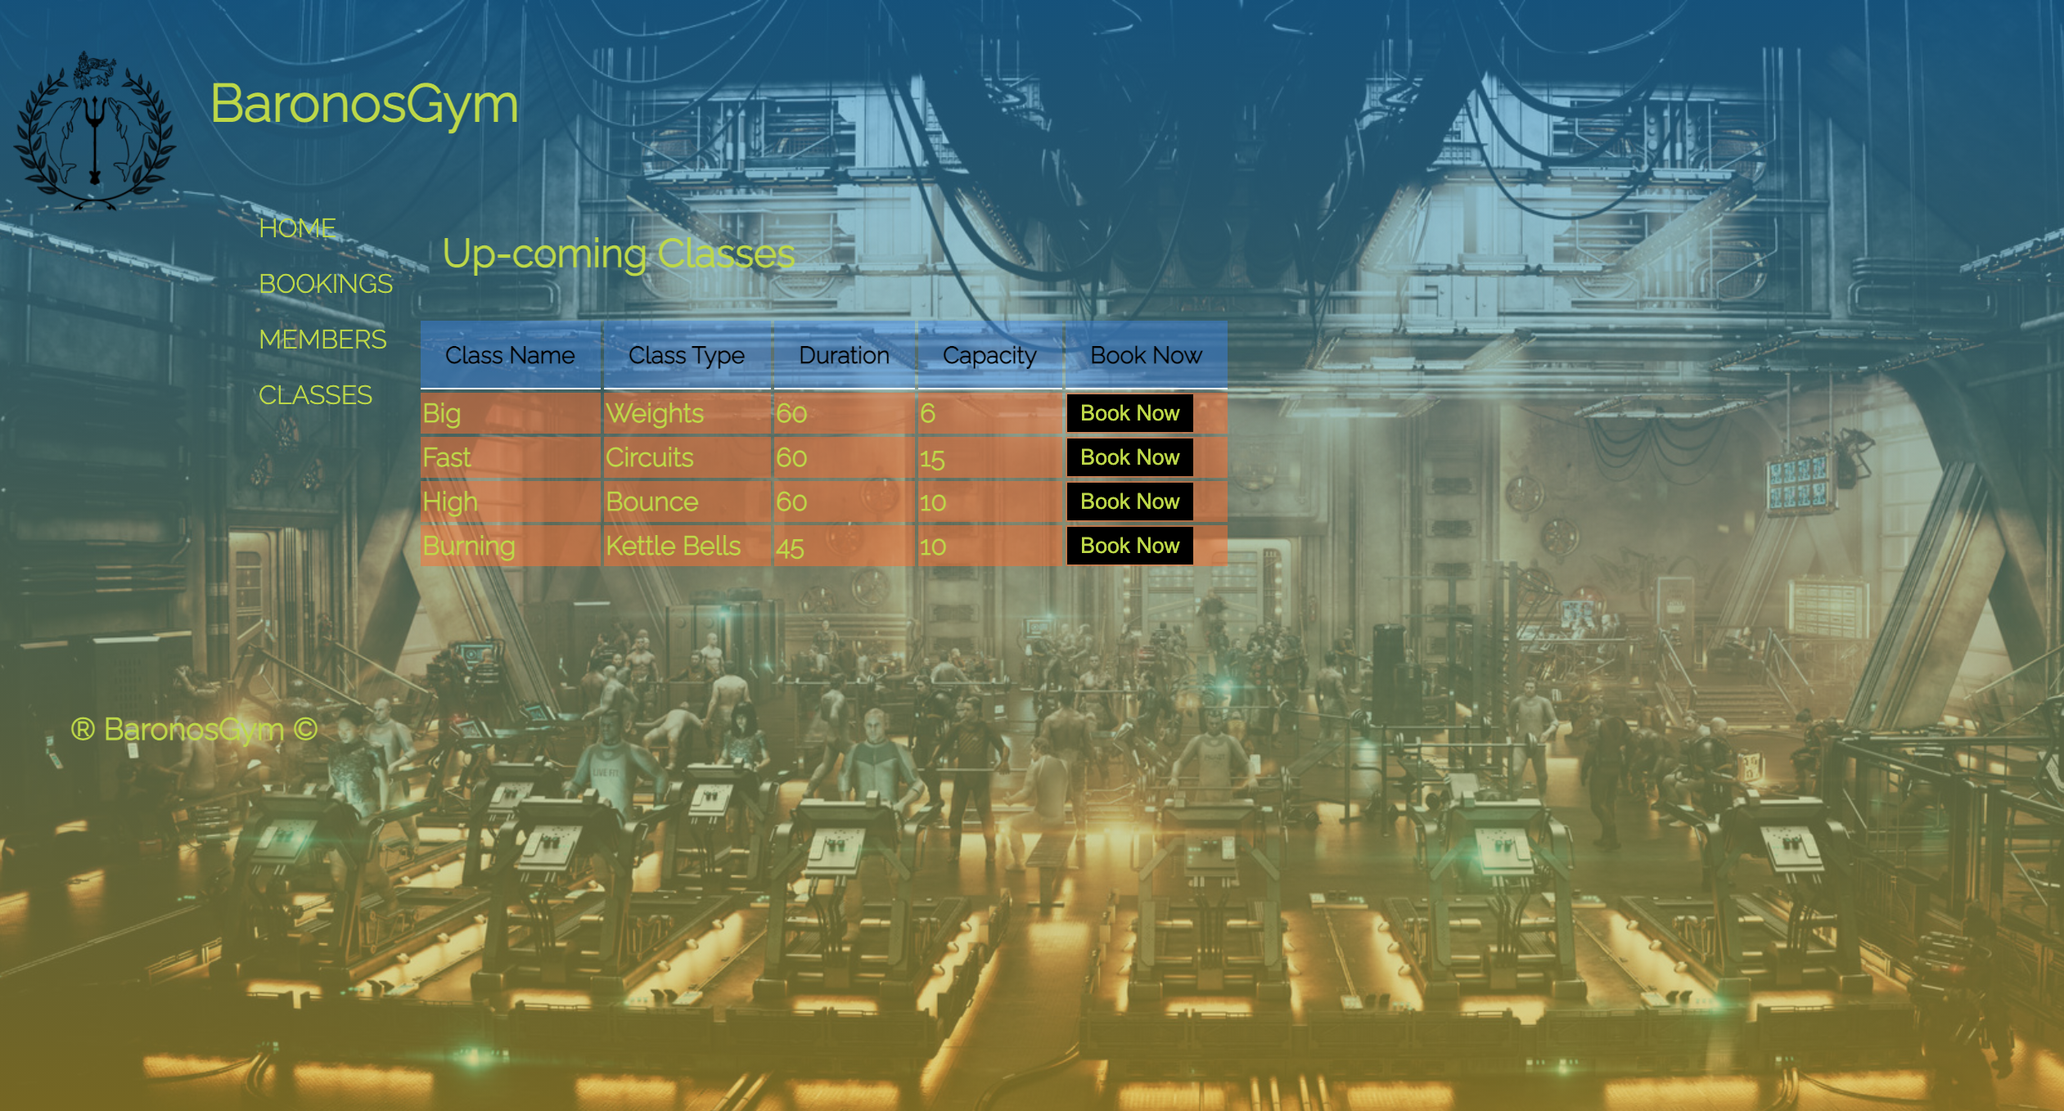
2. Highlights
Clearer comprehension of the links between different models/views (Back-end, front end….Fullstack);
Concept generation and format visualisation;
Planning & Evaluation;
Overarching processes;
Styling;
Functional routes and end logic.

Slide 4
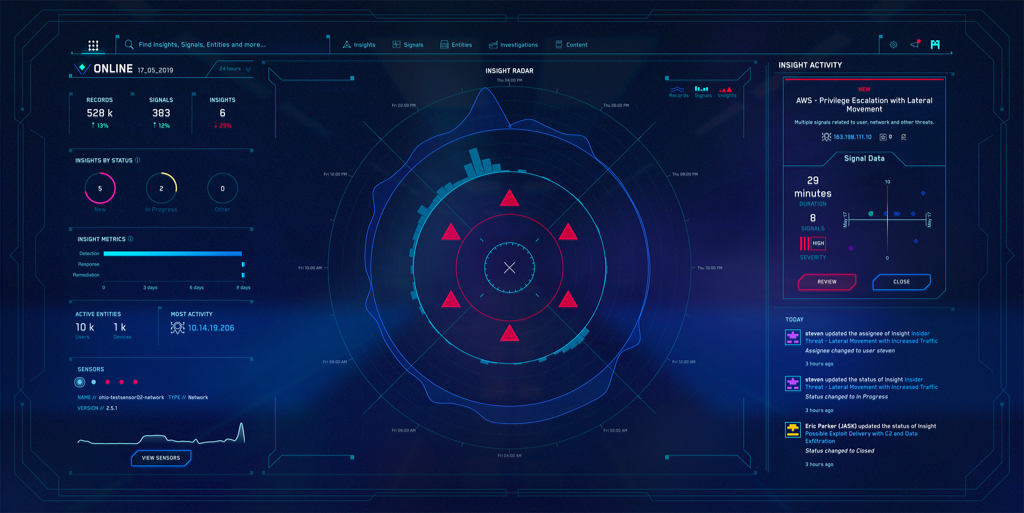
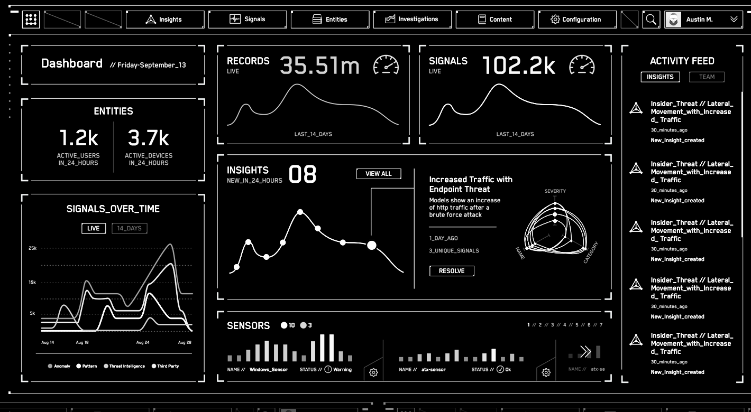
3. Challenges, Better-if & Next Steps
Challenges:
Calling, passing in & linking between Controller, Repository and HTML;
Heavy reliance on previous examples to construct app;
Spelling;
Motivation.
Better-if:
Managed time / commitments better;
Looked more futuristic / sci-fi;
Used grid template;
Built more functionality into data presented coupled with add-ons;
Used dates/time, class capacity, membership, Calendar views, Trainers, Streaks (target classes based on behaviour);
Better colour pallet.
Next Steps:
Build on Python functionality and capability to make apps more efficient;
Understand the gaps in my knowledge more clearly, seek to fill them;
Improve on the basics, practice and challenge myself outside of comfort zone;
Build a library of good code snippets;
Generate personal cheat sheet;
Reflect positively about what I have produced & keep motivated.

Slide 5
4. Questions
Any questions please?

